Slide 1

Mini Project Quest: Escape Room
Members:
Sandra Ngoing
Muskan Chawla
Carles Campdepadros Martin
Ugo Chikeize
Ricardo Golding

Slide 2
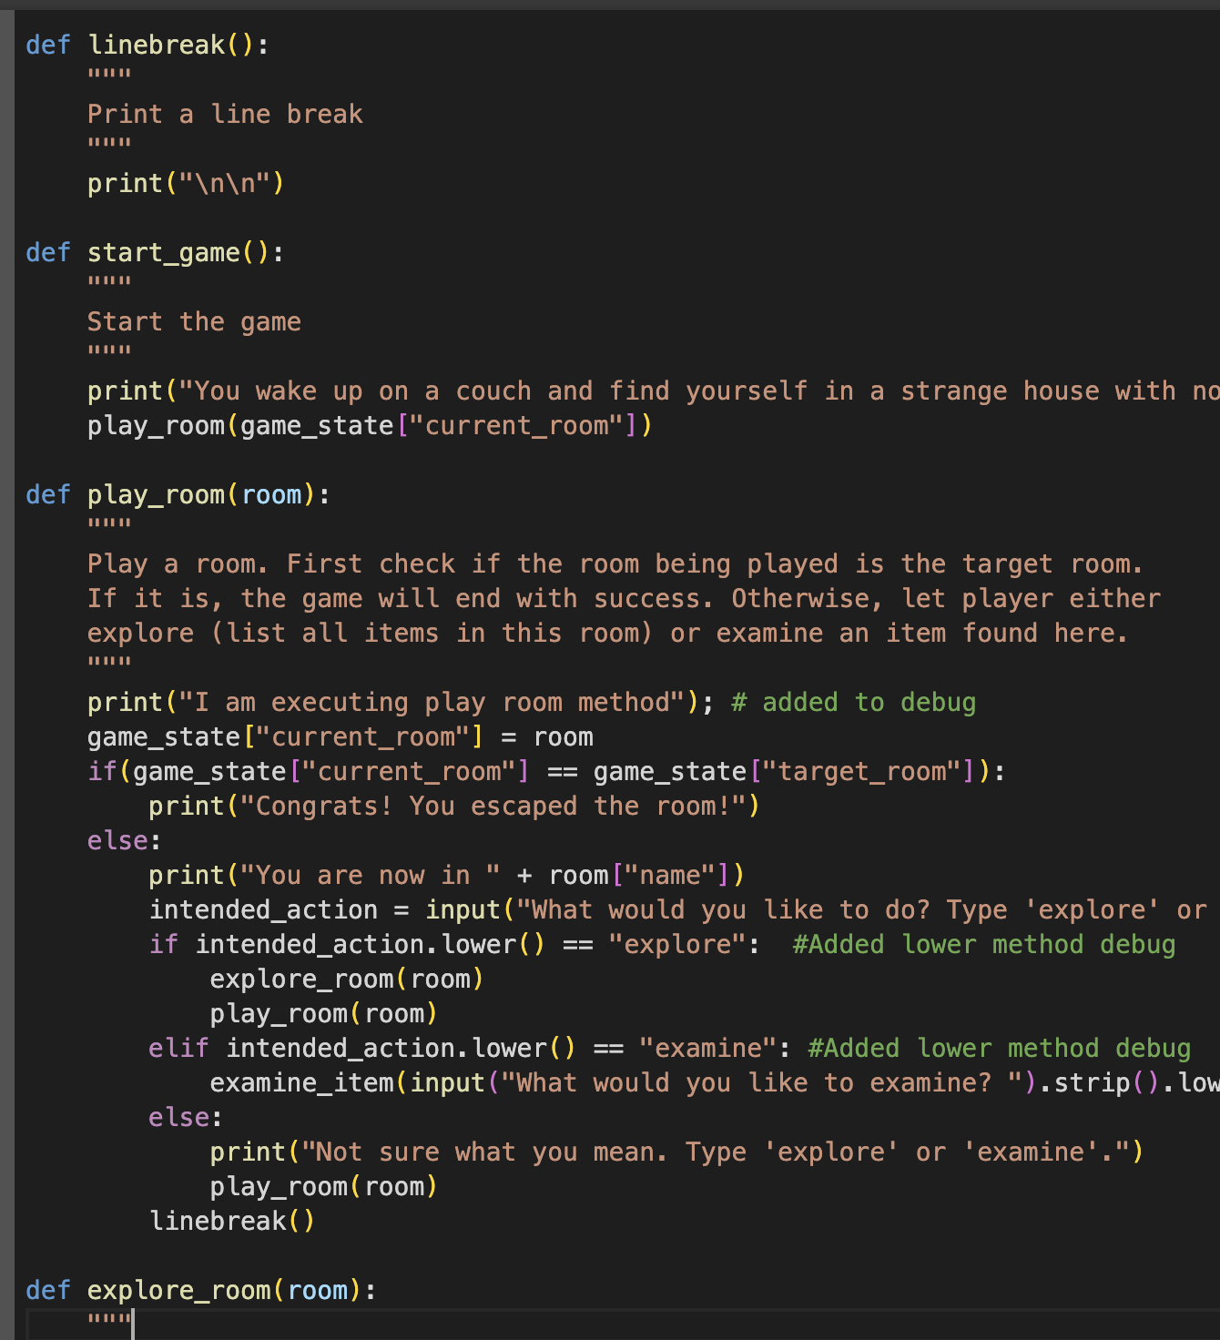
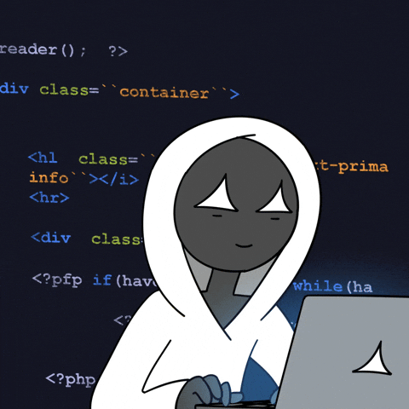
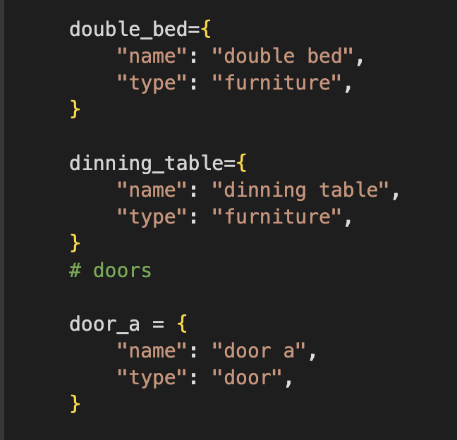

Slide 3

Project Overview
How is the game’s structured organized?
Project Folder:
Python functions file: separate file to improve organization and maintainability.
Main notebook file: variables and game starting point.
Which functions do you have and how are they imported?
Functions: start_game(), play_room(), linebreak(), explore_room(), get_next_room_of_door(), examine_item()
Attempted to import via separate python file under the same project folder though it did not work.
Which features did you add to the game?
Input handling to accept any upper case / lower case values.
Addition of multiple variables to be called by the functions.
Expand object relationships between items and doors to run the game code.

Slide 4
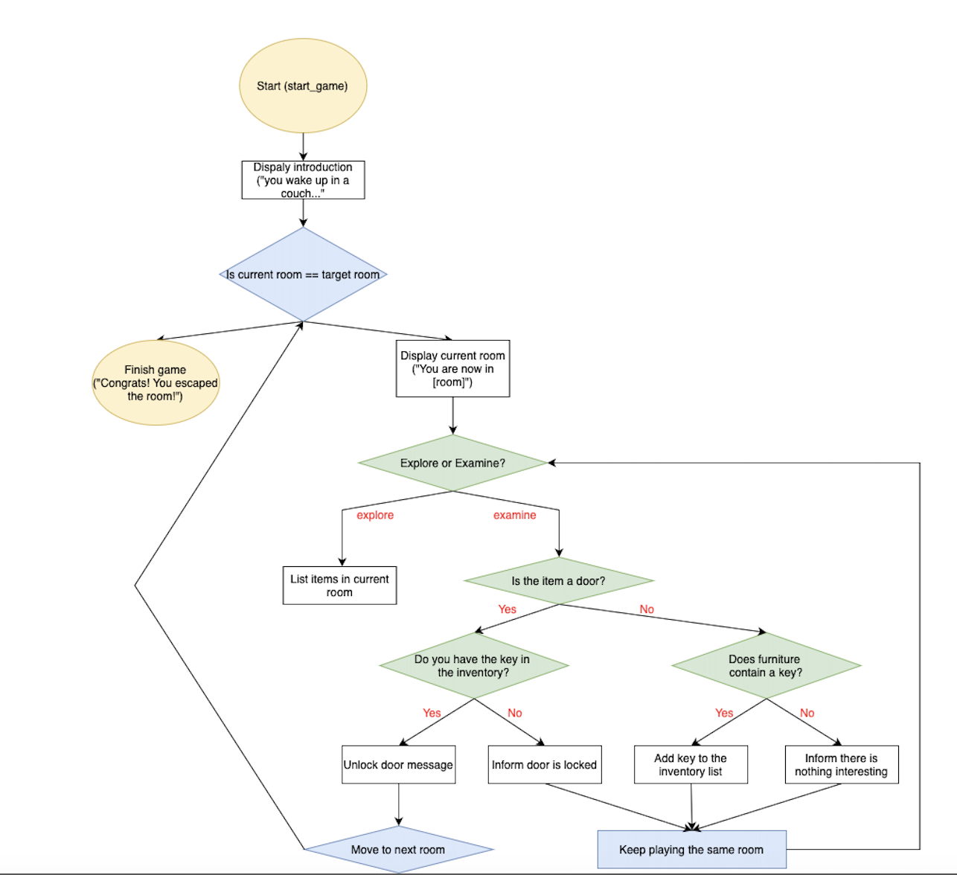
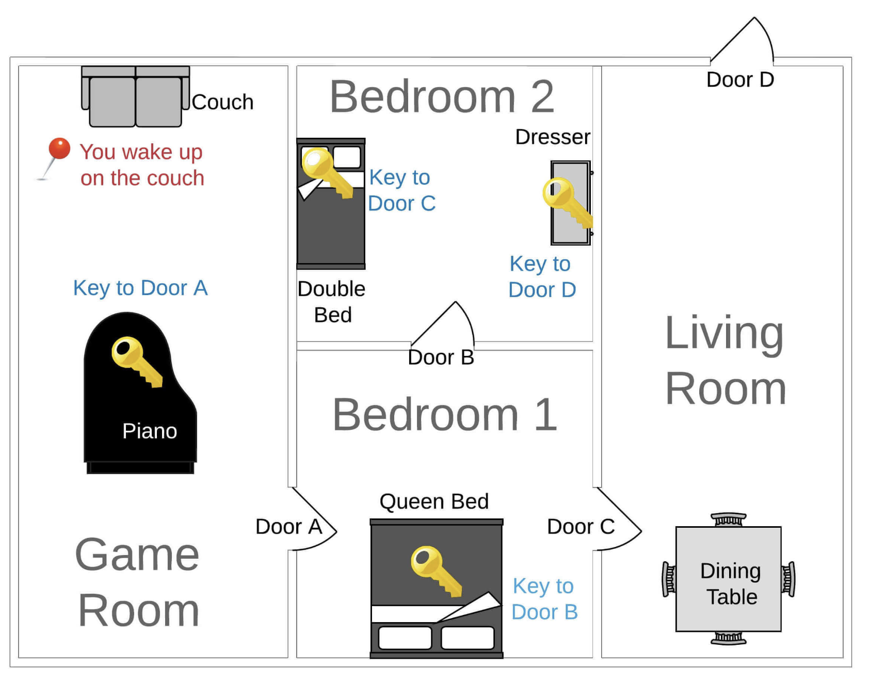

Slide 5

Technical challenge
What was the most important technical challenge you faced?
The biggest challenge was understanding the code, knowing where the elements were placed and how they related to each other.
Segregation the code using separate python files for functions/variables and importing it to the main notebook.
How did you overcome that challenge?
We first had to run and play the game first. Understanding the game was the first step. After playing, we were able to understand each step of the code and better see the components. Doing a diagram

Slide 6

Big Mistake
What was the biggest mistake you made during this project?
The biggest mistake we made was to not fully understand how to integrate/import the functions stored from another file to the main file.
What did you learn from it?
We learned that mistakes are part of the process and the best way to debug is to test the code and go step by step.

Slide 7

Demo Slide
Link:
https://colab.research.google.com/drive/1Woy0cpd5uhDltpKr2JJZ415lv_VgJxD5?usp=sharing

Slide 8

Mini Project Quest: Escape Room
Members:
Sandra Ngoing
Muskan Chawla
Carles Campdepadros Martin
Ugo Chikeize
Ricardo Golding

